Slide 1

DEPARTMENT OF ARTIFICIAL INTELLIGENCE AND DATA SCIENCE ACADEMIC YEAR 2025 - 2026 SEMESTER III ARTIFICIAL INTELLIGENCE LABORATORY MINI PROJECT REVIEW House Price Prediction Using Probabilistic Reasoning with Naive Bayes
REGISTER NUMBER | 2117240070054
NAME | S Devesh
YEAR | II
SECTION | A
FACULTY IN-CHARGE | Mrs. M. Divya

Slide 2
PROBLEM STATEMENT
Brief Overview of Artificial Intelligence Concepts:
Artificial Intelligence (AI) focuses on creating systems capable of intelligent decision-making. Game playing is a key domain for testing AI search algorithms.
Problem Statement:
To design a Tic-Tac-Toe game where the computer plays optimally using the Alpha-Beta pruning algorithm to minimize computation and ensure unbeatable performance.
Expected Result:
The AI will always play optimally, either winning or forcing a draw, providing an efficient and interactive GUI experience.

Slide 3
THEORETICAL BACKGROUND
Theoretical Background & Algorithm Overview:
Minimax Algorithm: Evaluates all possible moves to choose the best one.
Alpha-Beta Pruning: Optimizes Minimax by cutting unnecessary branches, improving efficiency.
Literature Survey & Alternatives:
Used in classical AI games (Chess, Checkers).
Reduces search complexity significantly.
Justification for Naive Bayes:
Alpha-Beta pruning maintains decision accuracy while improving performance, making it ideal for small games like Tic-Tac-Toe.

Slide 4
IMPLEMENTATION AND CODE
Link to code in Git-hub Repository
List | Git-hub Repository Links
Implementation of Code Link | https://github.com/devesh-54/Tic-Tac-Toe-AlphaBeta-AI/blob/main/tic_tac_toe_alpha_beta.py
Word Document Report Link | https://github.com/devesh-54/Tic-Tac-Toe-AlphaBeta-AI/blob/main/AILAB_MINI_PROJECT_DEVESH_AI%26DS.docx
PPT Link | https://github.com/devesh-54/Tic-Tac-Toe-AlphaBeta-AI/blob/main/AILAB_MINI_PPT_DeveshS_AI%26DS.pptx

Slide 5
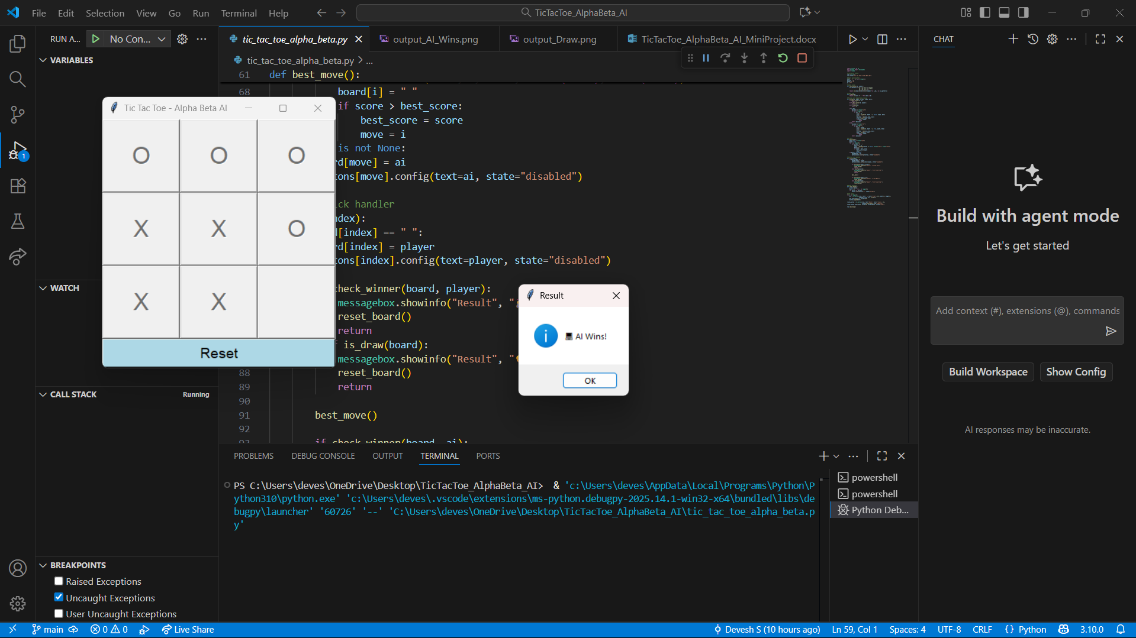
OUTPUT AND RESULTS
Description: The Tic-Tac-Toe game was successfully implemented with a user-friendly Tkinter GUI where the player (X) competes against the AI (O). The AI uses the Alpha-Beta Pruning algorithm to make intelligent and optimal decisions.
Output – AI Wins :
The AI analyzed all possible moves using the Alpha-Beta Pruning algorithm and selected the optimal path leading to a guaranteed win.
Unnecessary branches in the game tree were pruned, which reduced computation time and improved decision speed.
The AI demonstrated intelligent move selection, blocking the player’s winning chances and creating its own winning opportunity.
The game ended with the AI’s victory, proving the algorithm’s efficiency and accuracy in real-time gameplay.

Slide 6
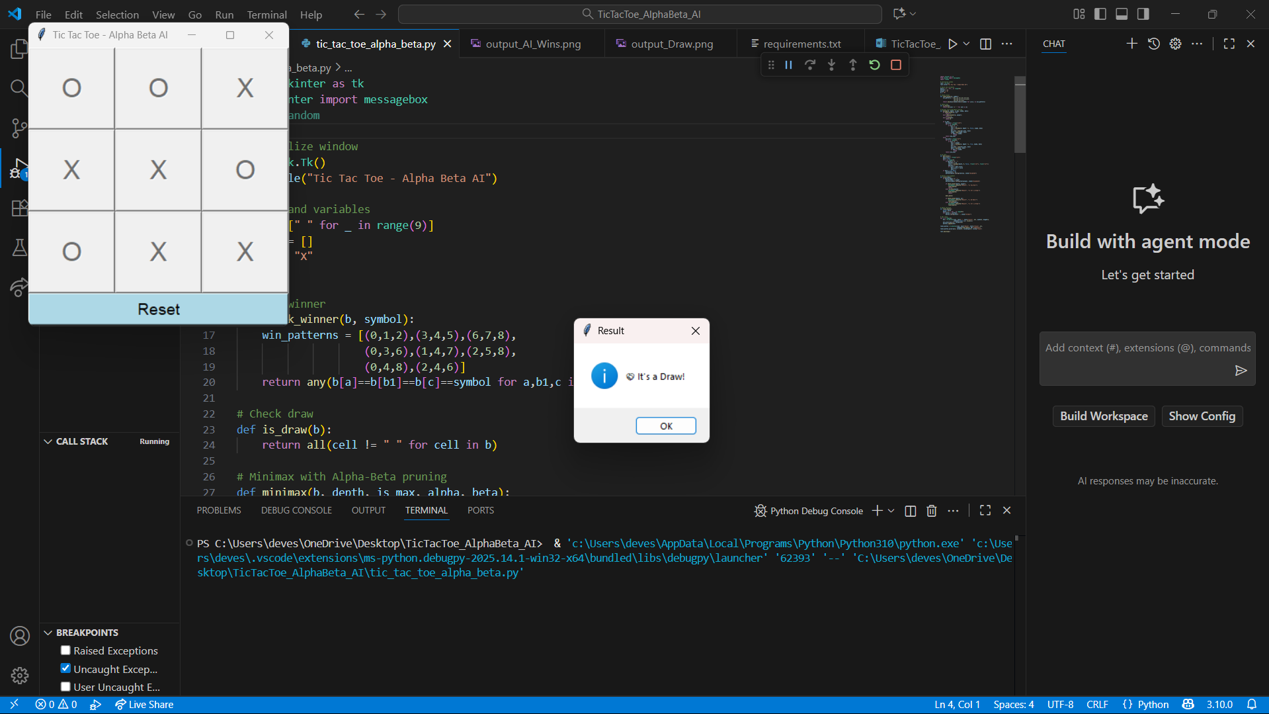
OUTPUT AND RESULTS
Output – Draw:
When both the player and AI played optimally, the game ended in a draw with no winning moves left on the board
The AI successfully blocked every possible winning path of the human player, ensuring it never loses
Alpha-Beta Pruning helped the AI evaluate only necessary moves, maintaining fast and efficient decision-making even until the final turn
The draw outcome proves that the AI’s strategy is unbeatable and always guarantees at least a tie against the human player

Slide 7
REFERENCES
References:
Stuart Russell and Peter Norvig, Artificial Intelligence: A Modern Approach.
TutorialsPoint – Minimax Algorithm in AI.
GeeksforGeeks – Alpha-Beta Pruning in AI.
Towards Data Science – Implementing Game AI using Minimax and Alpha-Beta Pruning
ResearchGate – Optimization Techniques in Game AI.

